Slide 1
INCLUDE Socioeconomic Disadvantage Framework
Dr Heidi Gardner, University of Aberdeen
Katie Biggs, University of Sheffield
Dr Fran Sherratt, University of Liverpool

Slide 2
Who is underserved by health research?
Note: Not the ‘hard to reach’ or ‘underrepresented’
NIHR INCLUDE Project:
Demographic factors Age, sex & gender, ethnicity, sexual orientation, education
Disease specific factors Rare disease and genetic sub-types, cancer metastasis
Health status Mental ill health, pregnancy, disability, co-morbidities
Social and economic factors

Slide 3
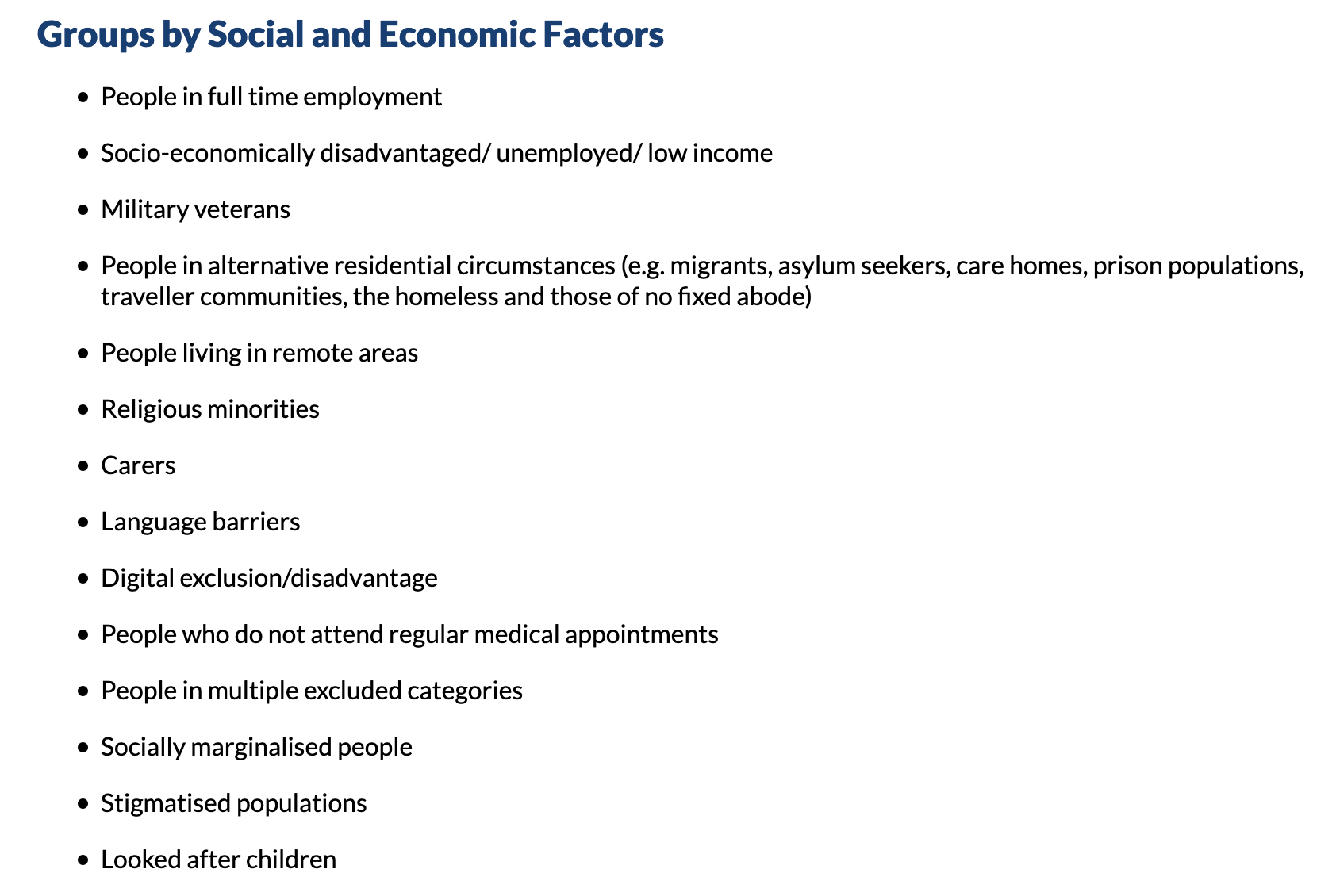

Slide 4
Why we need to think about socioeconomics
“The material conditions in which people grow up and live have a lasting impact on their personal and social identities, and this influences both the way they think and feel about their social environment, and key aspects of their social behaviour.”
Manstead, British Journal of Social Psychology, 2018.

Slide 5
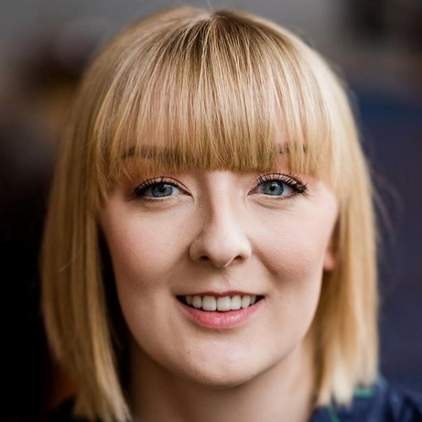
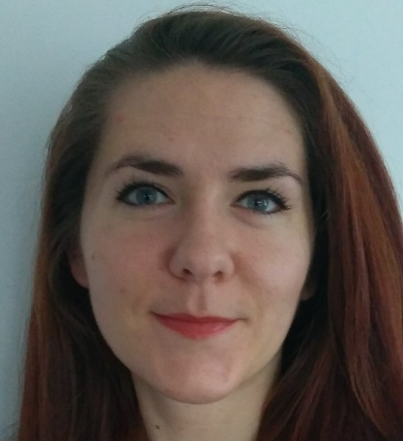
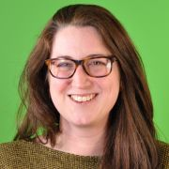
The INCLUDE Socioeconomic Framework
Framework to guide the design of clinical trials with inclusion of people experiencing socioeconomic disadvantage in mind.
Dr Heidi Gardner, Aberdeen
Dr Frances Sherratt, Liverpool
Katie Biggs,
Sheffield
A team of 6 patients and members of the public

Slide 6
What we knew going in
Socioeconomic status is not a protected characteristic
Dynamic, events and experiences can change quickly
Not something that you can see
Language and terminology is likely to be delicate and require sensitivity

Slide 7
Our definition
“Socioeconomic disadvantage is more than low income, it’s the combined outcome of various situations and experiences that can change over time, and describes the impact of a complex multidimensional problem that encompasses the social injustices and inequalities that contribute to further inequalities for people in our society that are already at their most vulnerable.”

Slide 8
Operationalising that definition
Used in the UK Government’s Child Poverty Strategy 2014-2017
Factors | Example
Pockets Income and resource availability | Being unable to work, insecure employment, “feeling powerless or vulnerable due to reduced income or resource availability”
Prospects Expectations and life chances | Low educational attainment and reduced literacy levels particularly around health, “acceptance of how it is”
Places Housing and the local environment | Reduced access to community services, lower engagement with NHS, homelessness, travelling communities

Slide 9
Building on what’s come before
INCLUDE Ethnicity Framework
4 Key questions, and a set of worksheets to support them
Launched in October 2020

Slide 10
Building on what’s come before
INCLUDE Ethnicity Framework
4 Key questions, and a set of worksheets to support them
Launched in October 2020

Slide 11
Barriers and strategies to make research more inclusive

Slide 12
10 Public
Contributors
Projects:
INCLUDE
CO-ACT Study
4 Online Meetings
3 Notetakers
Key Barriers and Strategies

Slide 13
Key points before we get started…
Socioeconomic disadvantage complex, multidimensional, and dynamic
Stigma but it’s an attribute – valuable perspective
Don’t categorise individuals but focus on making resources and processes simpler and show people they are valued
Diversify patient and public involvement and integrate throughout research lifecycle!

Slide 14
Pockets: Barriers and Strategies linked with income and economic resource availability
Taking part can leave people out of pocket!
Travel arranged in advance if possible
Consider factors that might impact use of public transport
Childcare support
Avoid research appointments outside of school hours

Slide 15
Pockets: Barriers and Strategies linked with income and economic resource availability
Technology, Work and Gov Benefits
Remote trials – good but need to consider tech barriers
Consider alternative formats and financial support for tech barriers (e.g. mobile data)
Time off work – flexible appointments and letter
Be clear about research payments and potential impact on benefits – cash OR vouchers?

Slide 16
Prospects: Barriers and Strategies linked with wellbeing and life chances
Accessible and engaging patient-facing materials
Overlaps with other underserved groups
Consent – concise, different formats, modes, languages & highlight key info
Avoid acronyms and jargon, visually appealing and use plain English
Be mindful of how information is sent

Slide 17
Prospects: Barriers and Strategies linked with wellbeing and life chances
Power dynamics, empowerment and trust
More vulnerable to low self esteem and mental health conditions
Worries about being judged – feeling out-of-place, untrusting and powerless
We need to do more to motivate patients, develop trust and balance power

Slide 18
Prospects: Barriers and Strategies linked with wellbeing and life chances
Power dynamics, empowerment and trust
Transparency - clear communication of patient and research benefit
Regular updates - how contribution helps
Fewer professionals in consultations, being accompanied by significant other, and potentially involving community champions.

Slide 19
Place: Barriers and strategies linked with housing and local environment
Access to services and research and stigma of place
In addition to financial expense, access to travel, childcare etc. might be limited
Choices for consultation environment, mode, and times.
Widen approaches to advertising inc. social media and local venues
Avoid making assumptions about where someone lives or asking where they live

Slide 20
Example application of the INCLUDE Socioeconomic Disadvantage Framework

Slide 21
Example application of the framework
ACCESS project to identify strategies
Redesign - applied retrospectively to 3 trials
Used the framework in preparation for redesign meetings
Barriers and strategies identified:
by the stakeholders in developing this framework
in the ACCESS project
experience working on trials

Slide 22
Study description
PICOS:
Population: Diagnoses of depression, recruited via GP
Interventions: 2 online CBT interventions
Comparator: Usual care provided by GPs
Outcomes: PHQ-9, other self-report measures
Study type: Individually randomised controlled, 3-arm, multicentre trial
Qualitative and cost-effectiveness work
Patient interview topics include computer literacy; views about CBT in future without consulting a health practitioner
Interviews with health professionals and managers

Slide 23
Worksheet A (Q2): Are people from different socioeconomic backgrounds likely to respond to the intervention in different ways?
 | Pockets | Prospects | Places | Other(s)
Health Condition
How might the prevalence of the health condition vary between people experiencing socioeconomic disadvantage and those who are not? | Feelings of powerlessness or vulnerability, lack of self esteem contribute to depression | SE disadvantage is linked to inequalities across healthcare, comorbidities | Limited healthcare access means less treatment for depression | There are issues defining and measuring SES
Perspectives
How or when might healthcare access vary between people experiencing socioeconomic disadvantage and those who are not? | Limited access to technological resources Time off work/childcare for appointments | Issues with health literacy and digital literacy (for access to healthcare apps) | Fewer GPs in areas of SE deprivation

Slide 24
Worksheet B (Q3): Will my trial intervention and/or comparator make it harder for people from different socioeconomic backgrounds to take part in the trial?
 | Pockets | Prospects | Places | Other(s)
What
How might the design/delivery of the intervention/comparator limit participation of people experiencing socioeconomic disadvantage compared to those who are not? | Limited time to complete due to work and childcare | Low literacy and digital literacy Not feeling educated enough to take part in a self-guided intervention | Access to GP for ‘usual care’ | Lack of social support might affect adherence to the intervention
How
How might the mode of delivery (e.g. telephone, video-call, face-to-face, in groups) limit the participation of people experiencing socioeconomic disadvantage compared with those who are not? | Limited access to technological resources, data and devices | Low digital literacy | Space at home to complete the intervention Access to GP or other venue to complete the intervention

Slide 25
Worksheet C (Q4): Will the way I have planned and designed my trial make it harder for people from different socioeconomic backgrounds to take part in the trial?
Worksheet C.1: Trial eligibility and accessibility factors that might affect how some groups engage with the trial
 | Pockets | Prospects | Places | Other(s)
Eligibility
How might eligibility criteria exclude people experiencing socioeconomic disadvantage for reasons other than their clinical eligibility for the trial compared with those who are not? | Not explicit in inclusion criteria but internet/mobile telephone access is required to take part in the intervention. | Excludes: suicidal, post-natal, bereaved, alcohol or drug abuse | Access to healthcare – registered with a GP, though screened with PHQ-9 | A concrete diagnosis of depression is sometimes difficult, especially for those not engaging in services, such as those who are not registered with a GP
Trial information
How might the way(s) (and by whom) potential participants are made aware of the trial limit the participation of people experiencing socioeconomic disadvantage compared to those who are not? | Letterheaded paper in brown envelope that has negative associations for participant (e.g. debt agency) | Low literacy considerations for information sheets | Recruitment only via GP | Power dynamics with recruiting staff. There was discussion of power imbalance, particularly with doctors and it was suggested that people use first names (which nurses tend to do more than doctors)

Slide 26
Worksheet C (Q4): Will the way I have planned and designed my trial make it harder for people from different socioeconomic backgrounds to take part in the trial?
Worksheet C.2: Trial data collection factors that might affect how some groups engage with the trial
 | Pockets | Prospects | Places | Other(s)
Who
How might the people who collect data limit the participation of people experiencing socioeconomic disadvantage (e.g. role, power dynamics, relationship) compared with those who are not? | Internet/mobile telephone access | Low self-confidence or motivation, which plays into perceived power disparities and mistrust |  | Power dynamics
Where
How might the location where trial data are collected limit participation of people experiencing socioeconomic disadvantage compared with those who are not? (e.g. no/limited disposable income for additional public transport, don’t drive, poor transport links, feeling uncomfortable in setting) | People may have limited time or money to travel to visits Remote collection has issue around digital access | Low self-confidence or motivation leading to more DNAs Remote collection has issue around digital access and digital literacy | Limited access to GPs, transport Private space in their home for completion could be limited

Slide 27
Worksheet C (Q4): Will the way I have planned and designed my trial make it harder for people from different socioeconomic backgrounds to take part in the trial?
Worksheet C.3: Factors that might affect the analysis of trial results
 | Pockets | Prospects | Places | Other(s)
Retention
How might the accuracy and completeness of trial data collected differ between participants experiencing socioeconomic disadvantage compared with those who are not? | People might drop out if they no longer have time, or money to take part | People might drop out of the find the language and processes difficult to engage with (literacy/digital literacy) Intersectionality – affected by things outside of the trial | Issues around housing instability for the duration of the trial | Data collection around SES variables is often poor and inconsistent
Trial Information
How might the possible harms of the trial intervention(s) differ between participants experiencing socioeconomic disadvantage compared with those who are not? | Too busy, or too worried about other things to notice harms, or differences in mood that other people might | Lower self esteem due to limitations around literacy Acceptance of ‘how it is’ | Limited social support

Slide 28
Worksheet C (Q4): Will the way I have planned and designed my trial make it harder for people from different socioeconomic backgrounds to take part in the trial?
Worksheet C.4: Factors that might affect the reporting and dissemination of trial results
 | Pockets | Prospects | Places | Other(s)
How, and in what way, might your reporting and dissemination of trial results limit engagement of people experiencing socioeconomic disadvantage compared with those who are not? Think about both the mode (i.e., how) and content (i.e., what) by which you are disseminating your results. |  | Literacy considerations | Access to the places that results are disseminated

Slide 29
Worksheet D: What measures can I put in place to address the identified factors that might prevent optimal participation of people experiencing socioeconomic disadvantage?
Factors that may prevent full community participation | Proposed measures (several options may be needed)
Literacy for understanding trial information, intervention content, outcomes and dissemination | Language should be a simple as possible for the trial and the intervention Work with appropriate PPI. Layered information. Videos.
Costs to taking part | Trial to provide any equipment needed, data and devices for remote delivery and transport.
Too busy to complete the follow-up | Focus on primary outcomes. Flexibility in how and when it can be completed. Routine data collection.
Power dynamics | Training for recruiting, intervention delivery and data collection staff.
Digital literacy necessary for intervention | Working with relevant populations prior to the trial to check digital literacy. Include training and additional support.
Potential for differential dropout | Measure SES variables. Try to find out people’s reasons for dropping out. Interview people from underserved groups that withdraw where possible.

Slide 30
Thank you to all stakeholders, especially INCLUDE public contributors: Firoza, John Roberts, Carolyn Graham, Philip Bell, Clara Martins de Barros, & Bola Aina. Thank you to Mariana Popa (University of Liverpool) and public contributors on the CO-ACT study.
Dr Heidi Gardner heidi.gardner1@abdn.ac.uk @heidirgardner
Katie Biggs c.e.biggs@sheffield.ac.uk @katiebiggsCTRU
Dr Fran Sherratt sherratt@liverpool.ac.uk @SherrattFrances
This project received funding from The University of Liverpool
https://www.trialforge.org/trial-forge-centre/socioeconomic-disadvantage-framework/

